Slide 1
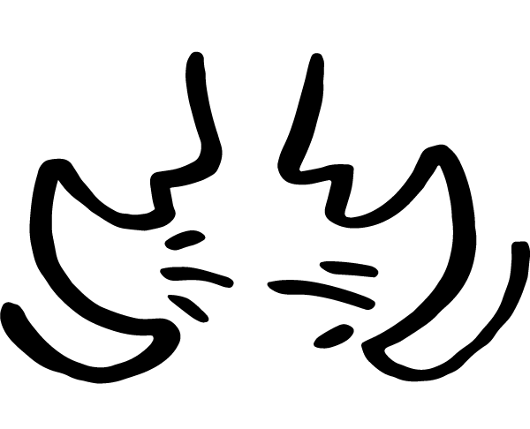
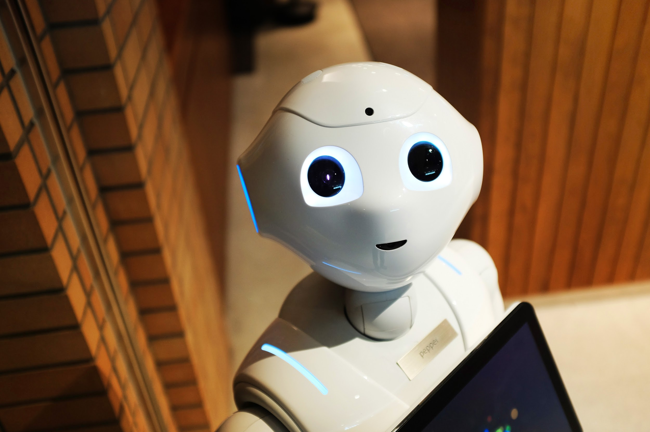
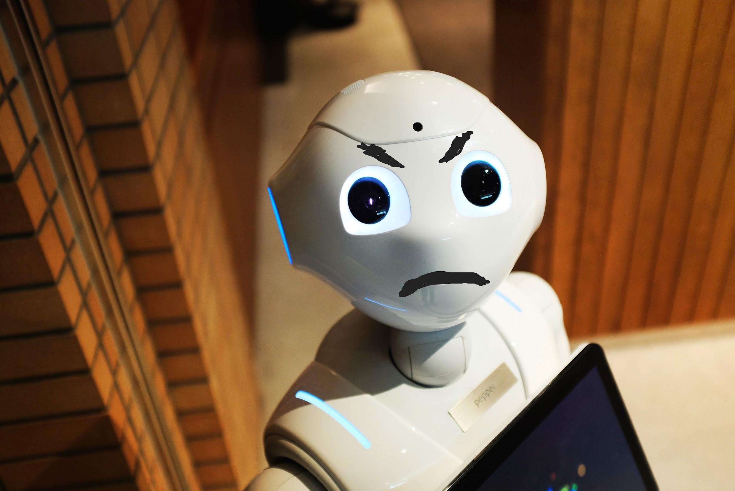
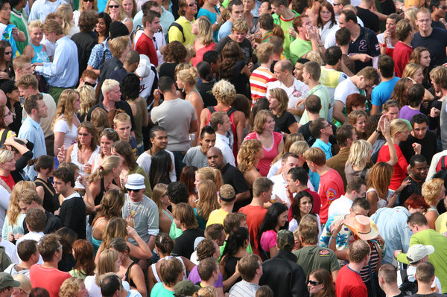
GRADES 3–5: DIGITAL CITIZENSHIP FAMILY ACTIVITY
News & Media Literacy
Digital citizenship: Thinking critically and using technology responsibly to learn, create, and participate
Instructions
It's important to look carefully at news and media. Look at how people can change or use pictures to fool others. Get one or more family members together to help. Don't forget to read the setup before doing the activity together!
Setup
Read aloud: Sometimes people will use a picture to try to prove something. The tricky thing is that people can change, or alter, the pictures. They can also use a picture that looks like it makes sense but is really from a different time or place. We can slow down and use our critical-thinking skills and online tools to get the facts.
Activity
Read aloud: Let's look at two pairs of pictures. In the first pair, let's find what's been changed. Then discuss why someone would change the picture. Then, let's look at the second pair: The picture was used like it was taken in a different place and time. Discuss why someone would use a picture in that way. After we discuss, let's check the solutions!
Original headline: Scientists make friendly robot
Changed headline: New robot gets angry at scientists
Original headline: A crowd waits for a band to start playing
Changed headline: Thousands gather to protest
Answer these questions together: Why would someone change these pictures like this? When we see people using pictures to prove something, how can we tell if they're real? Solutions: The picture of the robot might have been changed to convince people that robots are bad or scary. The second picture might have been used to portray a protest to convince people that a law or rule is wrong. If you read a story that uses a picture to prove something, you can drag the picture into the web search to find out where it's from!
Learn more about how to look carefully at the news at commonsense.org/family-tips-on-media-literacy!
commonsense.org/education
Shareable with attribution for noncommercial use. Remixing is permitted.

